Slide 1










E-Commerce Sales Dashboard
analysis & Insights

Slide 2
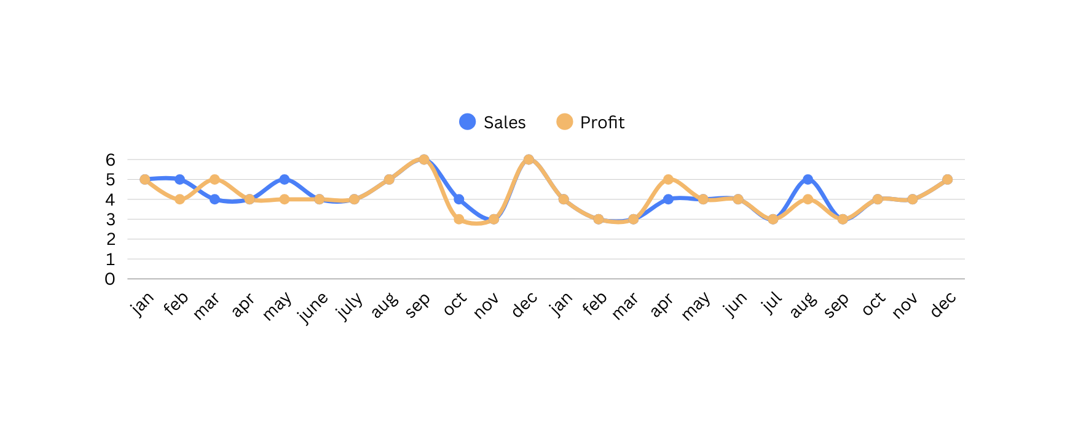
What is the total sales and profit by Year/Month?
2024: 49% 2025: 51%
Total Sales :
Total Profit :
$1.5M
Monthly sales fluctuate between 3% to 6%,
with peak performance around September and December.
In most times it is maintaining the same value showing that less percentage of losses.
$0.3M
Add a subheading

Slide 3
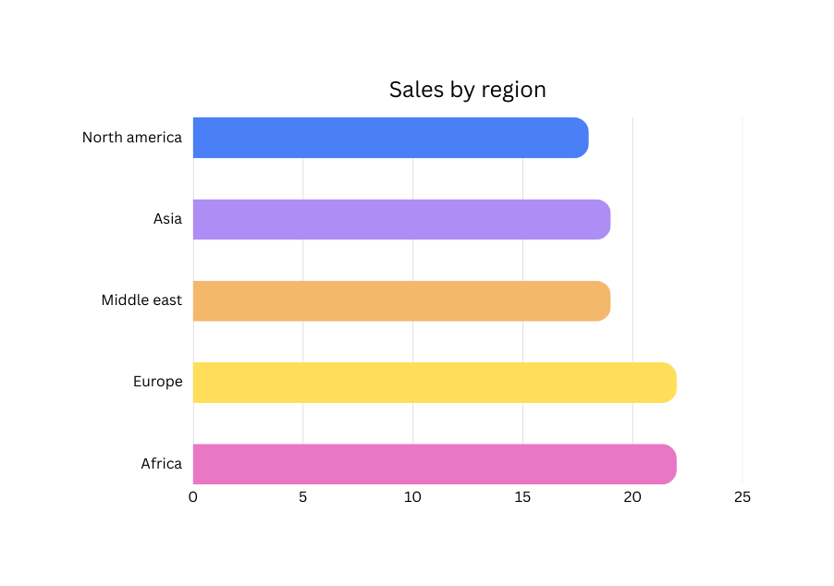
Which region generates the highest revenue?
Europe and Africa generate the highest revenue at 22% each.
followed by:
Middle east- 19%
Asia- 19%
North amercia- 18%

Slide 4
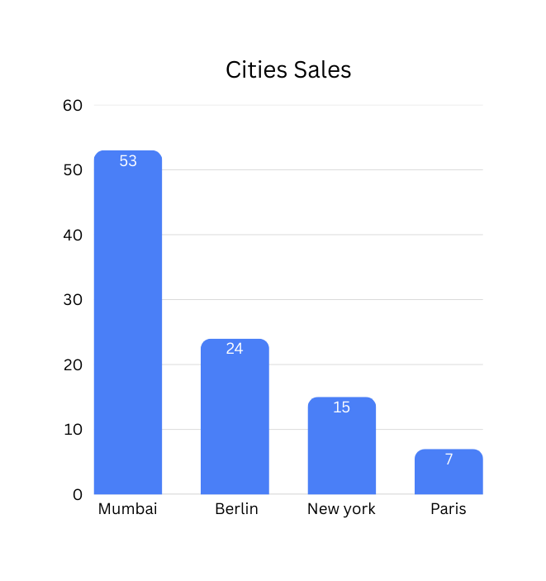
Which country and city perfom best?
Top Country: Germany(20% sales, 20% profit)
Top Profit: Dubai(53& contribution among top cities

Slide 5
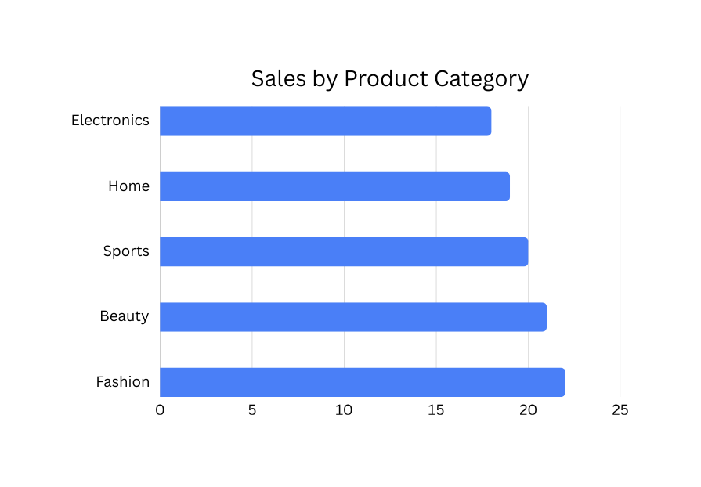
Which product category contributes most to sales?
The Fashion category contributes the most to sales with 22% share.
There is a equal increment from Electronics to Beauty.

Slide 6
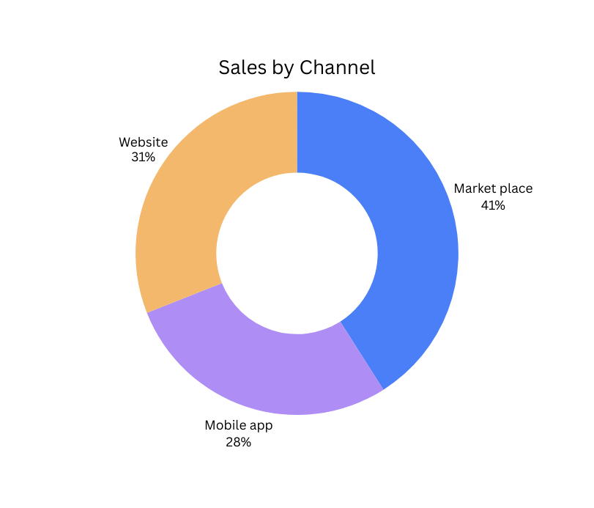
Which sales channel performs best?
Market place performs best, contributing 41% of total sales.
It outperforms Website and Mobile app.

Slide 7
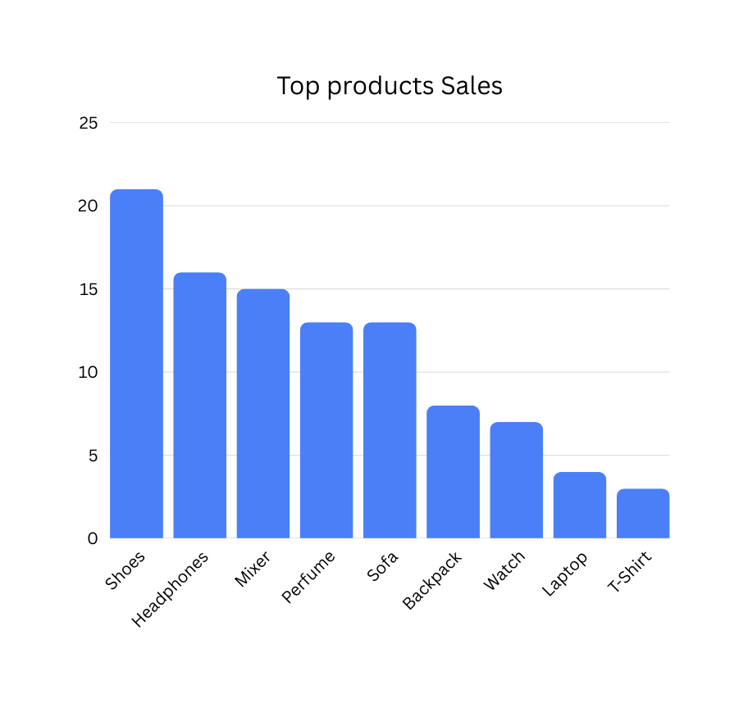
Which are the top 10 Products by sales?
Shoes is the top-Selling product, followed by Headphones and Mixer.
These products contribute the highest percentage of sales.

Slide 8
Conclusion
The company generated strong total sales and maintained a good progit margin of 22.59%.
Europe and Africa contribute the highest regional sales.
Fashion is the top-performing product category.
Market place is the best-performing sales channel.
The USA contributes the highest revenue and profit.

Slide 9








Customers Behaviour &
Segmentation Dashboard

Slide 10
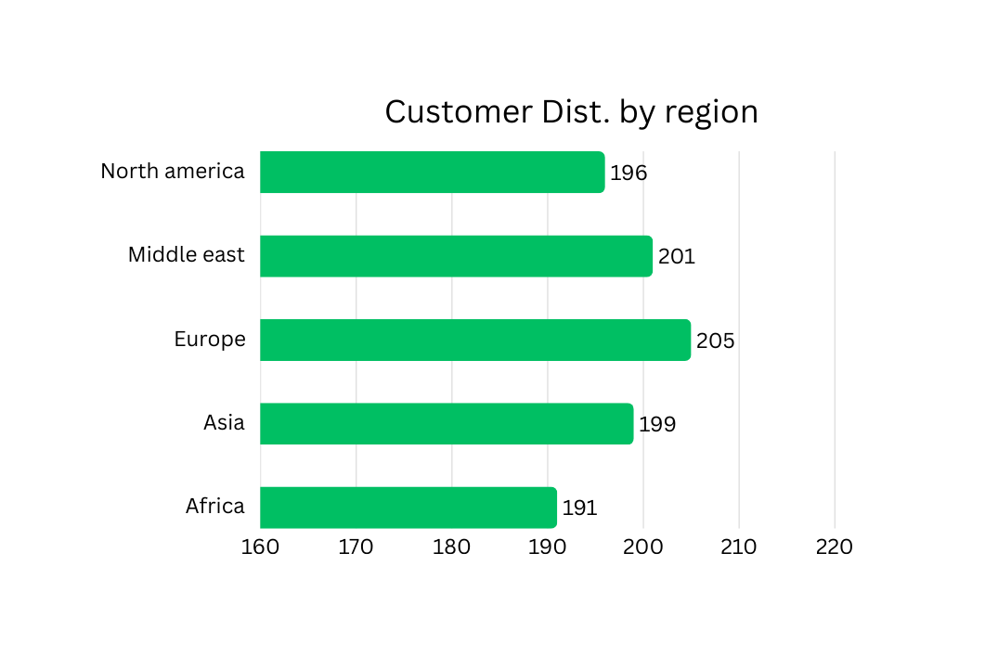
Which region has the highest number of customers?
Europe has the highest number of customers(205), followed by the Middle East (201).
Africa has the lowest customer count(191).
This shows that Europe is the strongest performing region in terms of customer bass.

Slide 11
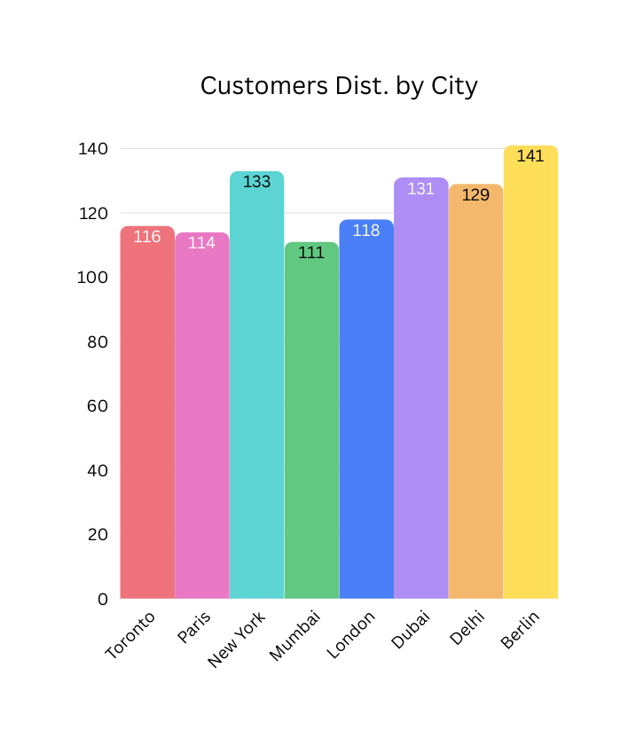
Which city has the most customers?
Berlin has the highest number of customers(141),
followed by New york(133) and Dubai(131).
This indicates strong urban market performances.

Slide 12
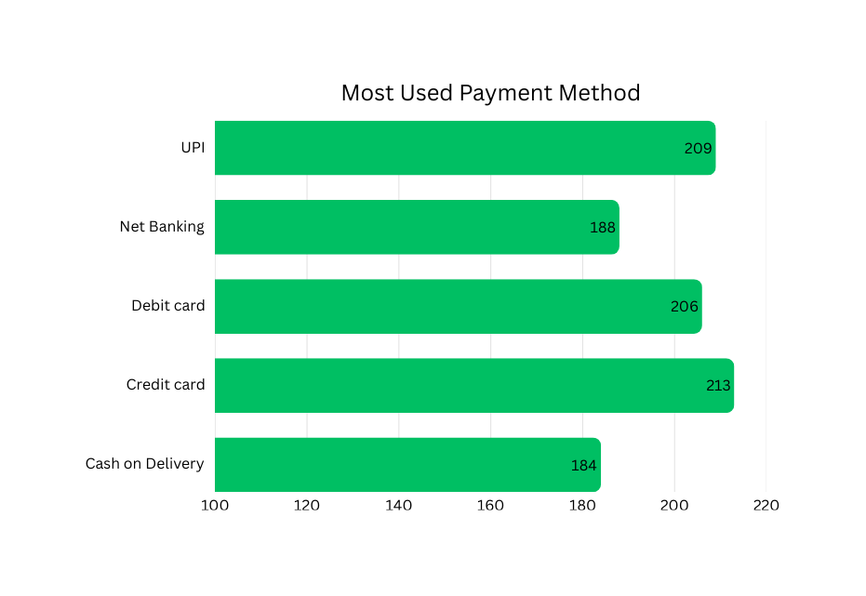
Which payment method is used the most?
Credit Card is the most used payment method
(213 transactions), followed closely by UPI(209 transactions).
This indicates strong digital payment adoption.

Slide 13
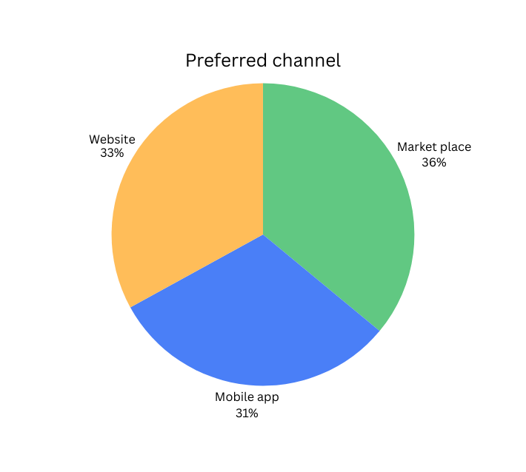
Which Channel is most preferred?
The most preferred channel is Marketplace(36%),
followed by Website(33%) and Market App(31%).
This shows customers prefer third-party platforms for purchases,

Slide 14
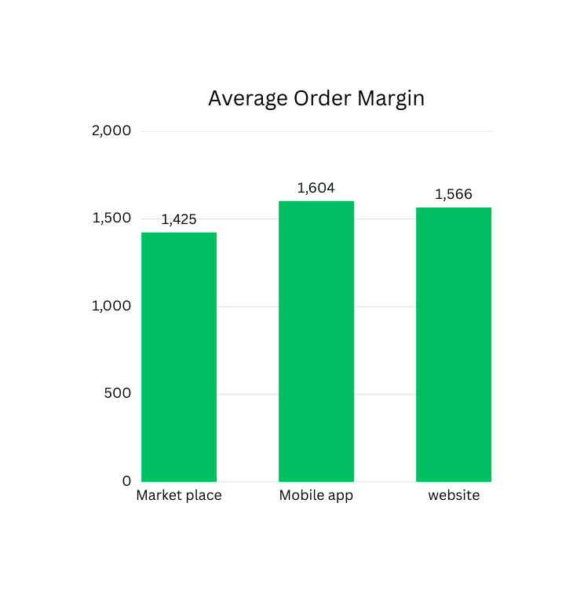
What is the Average Order Margin by Channel?
The Mobile App generates the highest average
order margin(1604), followed by Website(1566).
Marketplace generates the lowest margin(1425).

Slide 15
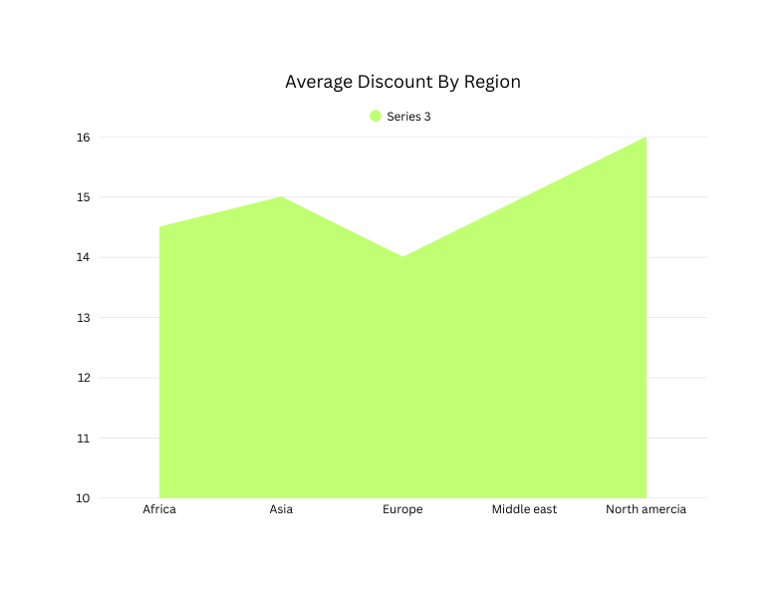
What is the average discount given by region?
The average discount ranges between 14% to 16% across regions.
North America provides the highest average discount(16%),
while Europe provides the lowest(14%).

Slide 16
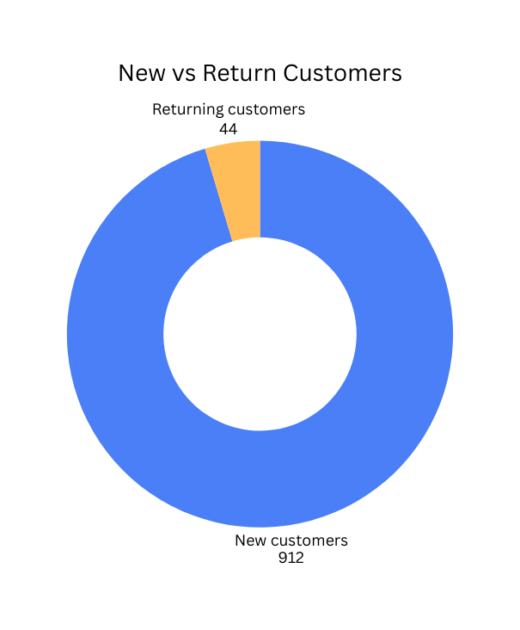
What is the difference between New and Returning Customers?
Out of 956 customers, 912 are new customers and only 44 are returning customers.
The repeat customer ratio is approximately 4.6%, which indicates low customer retention and an oppurtunity to improve loyalty programs.

Slide 17
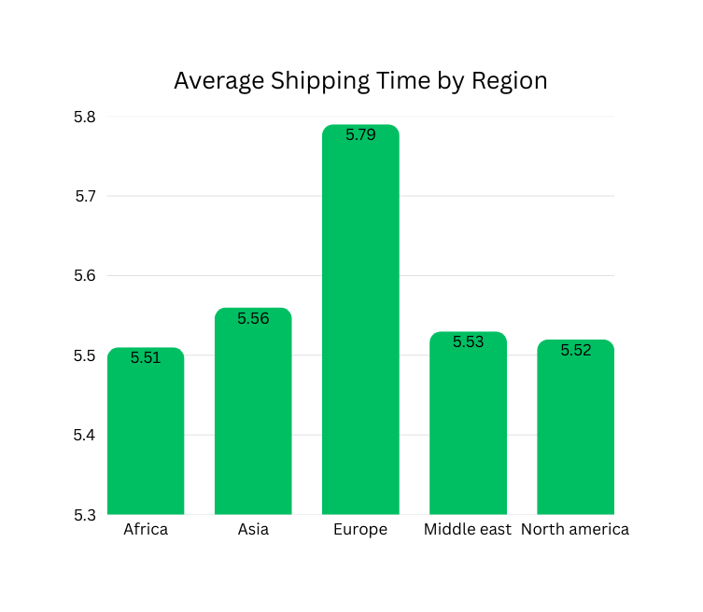
What is the average shipping time by region?
The average shipping time is approximately 5.5 days across all regions.
Europe has the highest shipping time (5.79 days), which may require logistics improvement.

Slide 18
Conclusion
The company has strong customer acquisition but low retention.
Europe is the leading region in customer count.
Market place is the most preferred channel.
Mobile App generates higher profitability.
Improving customer retention and reducing shipping time can increase overall performances.

Slide 19
Thank you

